Slide 1
CompTIA A+ Guide to IT Technical Support
10th Edition

Slide 2

Troubleshooting Windows Startup
Chapter 15

Slide 3
Objectives
Describe the boot process from the time you press the power button until the Windows desktop or Start screen loads
Create bootable media and backups to prepare for Windows startup problems
Implement appropriate Windows tools to solve Windows startup problems
Implement appropriate Windows tools to reimage or reload Windows
Troubleshoot Windows startup problems

Slide 4
Understanding the Boot Process
The better you understand what happens when you first turn on a computer until Windows is loaded, the more likely you will be able to solve a problem when Windows cannot start
Begin by noting the differences between a hard boot and a soft boot

Slide 5
Different Ways to Boot (1 of 2)
Two fundamental ways to boot a computer are:
Hard boot (cold boot): turning on the power with the on/off switch
Takes more time than a soft boot
Initializes the processor and clears memory
Soft boot (warm boot): using the OS to reboot
Initial steps performed by UEFI/UEFI/BIOS in a hard boot don’t happen
To save time use the soft boot to restart
If a soft boot doesn’t work, use a hard boot

Slide 6
Different Ways to Boot (2 of 2)
Power buttons and switches work like this:
Power button in front can be configured as a “soft” power button, causing a Windows restart
The reset button initializes the CPU
Restarts at the beginning of the BIOS/UEFI startup
Switch on the rear of the case turns off the power abruptly and is a “hard” power button
When Windows hangs, first try a restart
If that doesn’t work, try a shutdown and then power the system back up
If that doesn’t work, press the reset button on the front of the case
If that doesn’t work, turn off the power switch on rear of case, wait 30 seconds, turn it back on, and then press power button on the front of the case

Slide 7
Steps to Boot the Computer and Start Windows (1 of 5)
Use Table 15-1 in the text as a guide to study the steps to boot the computer
1. Startup BIOS/UEFI is responsible for the early steps in the boot process
Onboard RAM holds an inventory of hardware devices, hardware settings, security passwords, date and time, and startup settings
BIOS/UEFI reads this information and surveys the hardware devices it finds against the list kept in RAM
2. Startup BIOS/UEFI runs POST (power-on self test), which is a series of tests to find out if the firmware can communicate correctly with essential hardware components
3. Startup UEFI loads the UEFI boot manager and device drivers
4. The Windows Boot Manger reads the settings in the BCD

Slide 8
Steps to Boot the Computer and Start Windows (2 of 5)
5. Windows Boot Loader (winload.exe) is responsible for loading Windows components
6. The kernel (Ntoskrnl.exe) does the following:
Activates the HAL, reads more information from the registry, and builds into memory the registry key HKEY_LOCAL_MACHINE\HARDWARE
Starts critical services and drivers that are configured to be started by the kernel
After the kernel starts all services and drivers, it starts the Session Manager (Smss.exe), which runs in user mode
7. The Session Manager (Smss.exe) loads the graphical interface and starts the client/server run-time subsystem (csrss.exe)
8. Smss.exe starts the Logon Manager (winlogon.exe) and reads and executes other commands stored in the registry

Slide 9
Steps to Boot the Computer and Start Windows (3 of 5)
9. Winlogon.exe does the following:
Starts the Service Control Manager (services.exe)
Starts the Local Security Authority process (lsass.exe)
The sign-in screen appears and the user account and password are passed to the lsass.exe process for authenticating
Launches userinit.exe
10. Userinit.exe applies Group Policy settings and any programs not trumped by Group Policy that are stored in startup folders and startup registry keys
The Windows startup is officially completed with the Windows desktop or Start screen appears and the pinwheel wait icon disappears

Slide 10
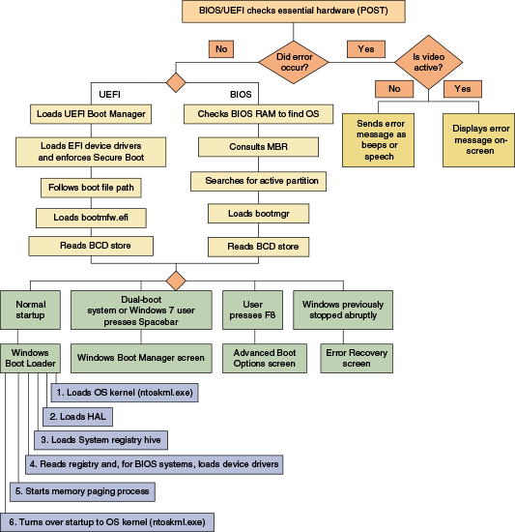
Steps to Boot the Computer and Start Windows (4 of 5)
Figure 15-2 Steps to booting the computer and loading Windows

Slide 11
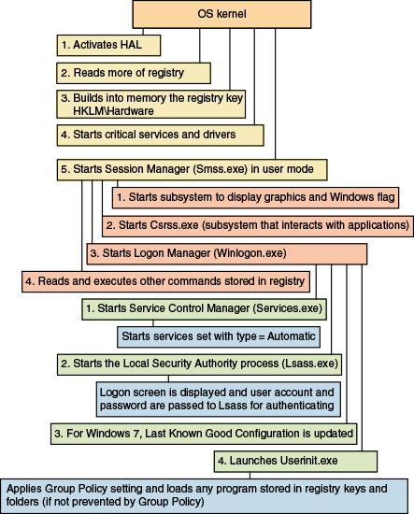
Steps to Boot the Computer and Start Windows (5 of 5)
Figure 15-3 Steps to complete loading Windows

Slide 12
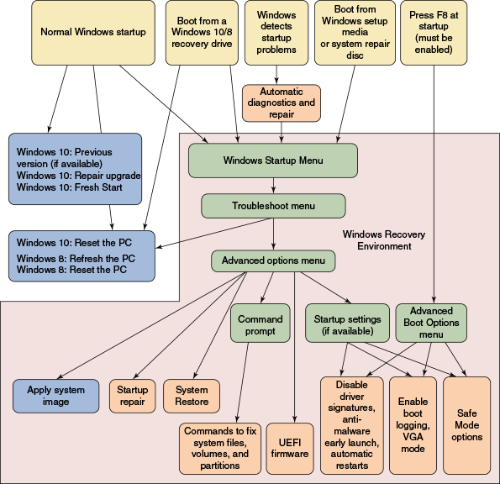
What To Do Before a Problem Occurs (1 of 3)
Figure 15-9 Methods to boot the system, menus that appear, and tools available on menus used to troubleshoot startup problems

Slide 13
What To Do Before a Problem Occurs (2 of 3)
While computer is still healthy:
Keep good backups
Create a system image
Configure Windows 10/8 to use the F8 key at startup
Gives you access to the Advanced Boot Options menu in Windows
Create recovery boot media
Windows 10/7 DVD system repair disc
Windows 10/8 USB recovery drive
Windows 10 setup media created by the Media Creation Tool

Slide 14
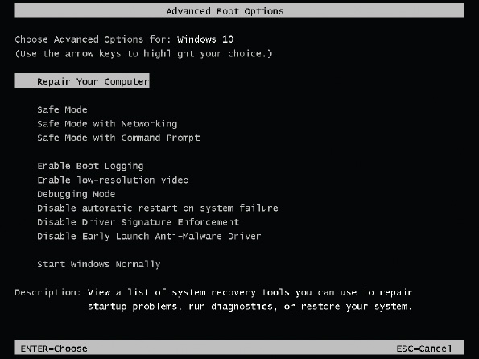
What To Do Before a Problem Occurs (3 of 3)
Figure 15-10 Use the Advanced Boot Options menu to troubleshoot difficult startup problems

Slide 15
Windows 10/7 System Repair Disc (1 of 2)
Create a system repair disc
You can use it to launch Windows RE
To create:
Click Create a system repair disc in the Backup and Restore (Windows 7) window
A 32-bit installation will create a 32-bit version of the repair disc and a 64-bit Windows installation will create a 64-bit version of the repair disc
Windows 8 has the option to create a system repair disc, but it is hidden

Slide 16
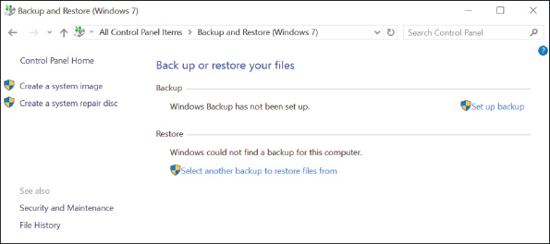
Windows 10/7 System Repair Disc (2 of 2)
Figure 15-11 Create a system image or a system repair disc from Control Panel

Slide 17
Windows 10/8 Recovery Drive (1 of 2)
Most computers include an OEM recovery partition on the hard drive that contains the drivers specific for the computer
Before a problem occurs, back up this OEM partition to a Windows recovery drive
A bootable USB flash drive that can access Windows 10/8 repair tools
To create a recovery drive:
Open Control Panel and click Recovery, click Create a recovery drive and respond to the UAC dialog box
Choose whether to include system files, click Next
Windows reports the size of the USB flash drive needed, insert drive
Windows inspects the size of the drive
If large enough, you see it listed among available devices, click Next, click Create to begin the process

Slide 18
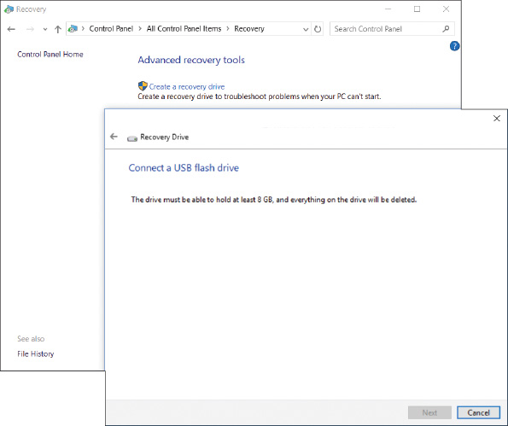
Windows 10/8 Recovery Drive (2 of 2)
Figure 15-13 Windows reports the size of the USB flash drive needed to hold the recovery drive

Slide 19
Windows 10 Media Creation Tool
You can launch Windows Re from a Windows setup DVD or flash drive
For Windows 10:
You can use the Media Creation Tool on a working computer to create a bootable Windows setup ISO file, DVD, or flash drive

Slide 20
Tools for Least Invasive Solutions
If Windows works well enough to get to the Windows desktop, use one of the following methods to launch Windows RE:
Windows 10 Settings app
Under Advanced startup, click Restart now
Shift + Restart
Click the Power icon, press and hold Shift and click Restart
Command prompt
Enter shutdown /r /o
Methods to launch Windows RE when Windows cannot start normally:
Windows detects startup problems and launches automatic diagnostics and repairs
Boot from a USB recovery drive, DVD system repair disc, or Windows setup DVD or USB drive
Press F8 during startup

Slide 21
Startup Repair
Startup repair is a built-in diagnostic and repair tool
Can fix Windows system files without changing Windows settings, user data, or applications
To run startup repair in Windows RE:
Drill down to the Advanced options screen and click Startup Repair
Windows RE examines the system, fixes problems, reports what it did, and might offer suggestions for further fixes
A log file of the process can be found at:
C:\Windows\System32\LogFiles\SRT\SRTTrail.txt

Slide 22
Changing Startup Settings (1 of 5)
The Startup Settings option on the Advanced options screen is available only when Windows RE is launched from the hard drive
Rather than another media
What these tools can do:
Press 1 or F1: Enable Debugging
Moves system boot logs from the failing computer to another computer for evaluation
Press 2 or F2: Enable Boot Logging
Windows loads normally
All files used during load process are recorded
C:\Windows\Ntbtlog.txt
See what did and did not load during the boot

Slide 23
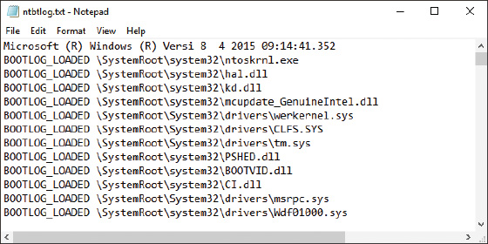
Changing Startup Settings (2 of 5)
Figure 15-23 A sample C:\Windows\Ntbtlog.txt log file

Slide 24
Changing Startup Settings (3 of 5)
What these tools can do (continued):
Press 3 or F3: Enable Low-Resolution Video
Used when the video setting does not allow screen to display well enough to fix a bad setting
Can also use this option for problems with video drivers
Press 4 or F4: Enable Safe Mode
Launch antivirus software
Open Event Viewer
Run the System File Checker command
Use Device Manager to roll back a driver
Use Memory Diagnostics to verify memory
Use the chkdsk /r command to check for file system errors
Configure Windows for a clean boot on next restart
Perform other troubleshooting tasks

Slide 25
Changing Startup Settings (4 of 5)
What these tools can do (continued):
Press 5 or F5: Enable Safe Mode with Networking
Use when solving a problem with booting and network access is needed
Also use when the Windows installation files are available on the network
Press 6 or F6: Enable Safe Mode with Command Prompt
Use the sfc /scannow command to verify system files
If problem not solved, launch System Restore
C:\Windows\system32\rstrui.exe

Slide 26
Changing Startup Settings (5 of 5)
What these tools can do (continued):
Press 7 or F7: Disable Driver Signature Enforcement
All 64-bit editions of Windows require that kernel-mode drivers be digitally signed
Disabling this option is used by developers who are testing kernel-mode device drivers
Press 8 or F8: Disable Early Launch Anti-Malware Driver
Windows 10/8 allow antivirus software to launch a driver before any third-party drivers are launch so it can scan drivers for malware
Press 9 or F9: Disable Automatic Restart on System
Stop rebooting upon encountering a system failure
Press F10: Return to the Startup Settings Screen
Return to Windows Startup Menu screen

Slide 27
System Restore
You can select System Restore from:
The Windows RE Advanced options screen
The Windows 7 System Recovery Options screen
Within Safe Mode
A command prompt with the rstrui command
System Restore can cause a problem of its own
Windows updates and updates to anti-malware software can be lost and hardware devices and apps might need to be reinstalled
Won’t help if the file system or registry is corrupted

Slide 28
The Command Prompt Window in Windows RE (1 of 6)
Use this when the graphical interface is missing or corrupted
Or if you want to use a specific command to fix a problem when Windows refuses to start
You have administrator privileges and full read and write access to all files on all drives
To access the Windows RE command prompt:
Click Command Prompt on the Windows 10/8 Advanced options screen or the Windows 7 System Recovery Options screen

Slide 29
The Command Prompt Window in Windows RE (2 of 6)
Manage Data Files and System Files
Use the SFC or DISM commands to restore critical Windows system files
Use cd, copy, rename, and delete commands to manage data and system files
Restore registry files using those saved in the RegBack folder
After each fix, reboot the system to see if problem was solved
Use commands in Table 15-2 (see next slide) to restore registry files

Slide 30
The Command Prompt Window in Windows RE (3 of 6)
Command Line | Description
1. c: | Makes drive C: the current drive. The default directory is root.
2. dir | Examines the contents of drive C:. If this is not your Windows volume, try a different drive letter.
3. cd \windows\system32\config | Makes the Windows registry folder the current folder.
4. ren default default.save 5. ren sam sam.save 6. ren security security.save 7. ren software software.save 8. ren system system.save | Renames the five registry files.
9. cd regback | Makes the registry backup folder the current folder.
10. copy system c:\windows\system32\config | For hardware problems, first try copying just the System hive from the backup folder to the registry folder and then reboot.

Slide 31
The Command Prompt Window in Windows RE (4 of 6)
Command Line | Description
11. copy software c:\windows\system32\config | For software problems, first try copying just the Software hive to the registry folder and then reboot.
12. copy system c:\windows\system32\config 13. copy software c:\windows\system32\config 14. copy default c:\windows\system32\config 15. copy sam c:\windows\system32\config 16. copy security c:\windows\system32\config | If the problem is still not solved, try copying all five hives to the registry folder and reboot.

Slide 32
The Command Prompt Window in Windows RE (5 of 6)
Repair the Hard Drive File Systems and Partitions
Use chkdsk /r to repair the file system
Use diskpart to manage hard drives, partitions, and volumes
Enable Networking
Networking is not normally available from the Windows RE command prompt
Use the wpeinit command to enable networking
Use Bootrec and Bcdedit to Repair the File System and Key Boot Files
Use the bootrec command to repair the BCD and boot sectors
Use the bcdedit command to manually edit the BCD
Use the bootsect command to repair a dual boot system

Slide 33
The Command Prompt Window in Windows RE (6 of 6)
Command Line | Description
bootrec /scanOS | Scans the hard drive for Windows installations not stored in the BCD
bootrec /rebuildBCD | Scans for Windows installations and rebuilds the BCD
bootrec /fixboot | Repairs the boot sector of the system partition
bootrec /fixmbr | Repairs the MBR for hard drives using the MBR partitioning system
bcdedit /enum | Displays the contents of the BCD

Slide 34
Options to Reinstall Windows
After you have made reasonable efforts to repair a Windows installation, your next option is to reinstall Windows
List of options, starting with the least intrusive solution:
Windows 10/8 previous version
Windows 10 repair upgrade
Windows 10 Fresh Start
Windows 10 reset
Windows 8 refresh
Apply a Windows 10/7 system image
Windows 8 reset
Install Windows 10/8/7 from the OEM recovery partition
Windows 10/8/7 clean install from setup media

Slide 35
Windows 10 Previous Version (1 of 2)
Minor updates to Windows are distributed on the second Tuesday of each month
Major updates are called versions are distributed once or twice a year
If a new version if giving you problems:
You can revert your system back to the earlier version as long as:
(1) the version was installed within the last 10 days
(2) you have not reset your computer during this time
(3) the Windows.Old folder has not been deleted

Slide 36
Windows 10 Previous Version (2 of 2)
To roll back Windows updates:
From the Windows desktop:
Open Settings app, click Update & security, and then click Recovery
Under Go back to the previous version of Windows 10, click Get started
From Windows RE:
If the option is available, you can see it on the Advanced options screen in Windows RE
Use this method when a new version has caused the system to fail to start

Slide 37
Windows 10 Repair Upgrade
A repair upgrade is a nondestructive installation of Windows 10 over an existing Windows installation
Keep these points in mind when doing a repair upgrade:
Create Windows setup media, either on DVD or USB, or save an ISO file on the local hard drive
Make sure that you can fully boot into Windows 10
Even though all data, apps, and settings should be protected in a repair upgrade, make a backup just in case
Gather all product keys for all installed apps to make reinstallation of these apps easier should it become necessary

Slide 38
Windows 10 Fresh Start (1 of 3)
A Fresh Start performs a clean installation of the most recent version of Windows 10 and is often used to remove manufacturer bloatware
What is installed, kept, and not kept with a Fresh Start:
Installed: the latest generic copy of Windows, free from manufacturer bloatware
Kept: user accounts, their settings, and personal data are kept as well as some Windows settings
Microsoft apps that are natively integrated in Windows and Microsoft store apps installed by the computer manufacturer are also kept
Not kept: all apps are removed, except as stated above
A list of removed apps is displayed on the desktop after the Fresh Start completes
You also lose any manufacturer drivers or OEM system files

Slide 39
Windows 10 Fresh Start (2 of 3)
To install a fresh copy of Windows 10:
Make sure you’re connected to the Internet and you have sufficient storage space
Open the Settings app, click Update & security, and then click Recovery
Under More recovery options, click Learn how to start fresh with a clean installation of Windows
Then click Yes to switch to the Fresh start page
Click Get Started to begin the process

Slide 40
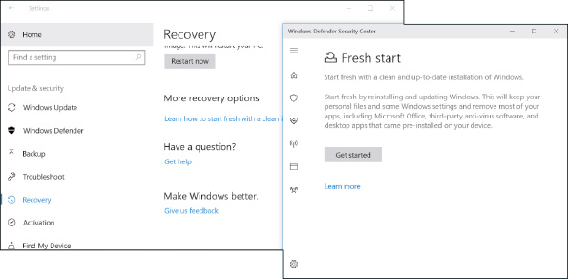
Windows 10 Fresh Start (3 of 3)
Figure 15-31 Personal files are kept when executing a Fresh Start for Windows 10

Slide 41
Windows 10 Reset
Windows 10 reset reinstalls Windows with the option of keeping:
User accounts, some Windows settings, and all personal data files
During a reset:
Any apps or drivers that were installed from third-party providers will be removed
Some changes made to Windows settings will be lost
If you’re using a Microsoft account, you can choose to have many Windows settings automatically resynced to the device

Slide 42
Applying a Windows 10/7 System Image
To recover Windows 10/8 using a system image file:
Reboot the computer into Windows RE, drill down to the Advanced options screen, and select System Image Recovery
For Windows 7:
Select System Image Recovery on the System Recovery Options screen

Slide 43
OEM Factory Recovery Partition (1 of 3)
Laptops and brand-name desktops likely have a recovery partition on the hard drive
Contains a copy of the OS build, device drivers, diagnostics programs, and preinstalled applications
Partition might or might not be hidden
To know how to access the recovery tools stored on the recovery partition
See the manufacturer’s website or look for a message at the beginning of the boot
If the laptop doesn’t have a recovery partition or the partition is corrupted:
Look for the option to download recovery media from the manufacturer’s website and use it to create a bootable USB flash drive or DVD

Slide 44
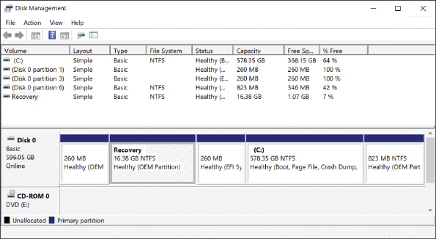
OEM Factory Recovery Partition (2 of 3)
Figure 15-36 This laptop hard drive has a 16.38-GB recovery partition that can be used to recover the system

Slide 45

OEM Factory Recovery Partition (3 of 3)
Figure 15-37 For this laptop, press the Assist button during the boot to launch programs on the recovery partition

Slide 46
Installing Windows Over the Network
You must boot the computer to the network
Where it finds and loads Windows PE on the deployment server
Go into BIOS/UEFI setup, look for an advanced setup screen to enable PXE Support
Computer then boots to the Preboot eXecution Environment (PXE)
PXE searches for a server to provide Windows PE and the deployment image

Slide 47
Troubleshooting Specific Windows Startup Problems
When troubleshooting a startup problem:
Follow procedures to interview the user
Back up important data or verify you have current backups
Research and identify any error messages
Determine what has just changed that might be the source of the problem
When you know the source, decide which tool will be the least invasive to use, yet still fix the problem

Slide 48
Important Data on the Hard Drive
Always start with the question:
“Is there important data on the hard drive not backed up?”
If data is lost or corrupted:
Use Windows tools, third party software, or commercial data recovery services
Use a SATA-to-USB converter kit to temporarily connect a desktop or laptop hard drive to a USB port on a working computer
Use File Explorer or Windows Explorer to copy data to other media

Slide 49
Error Messages and Problems (1 of 11)
Problems that prevent Windows from booting can be caused by hardware, device drivers, services, application, or Windows
Startup Error Messages on a Black Screen
Problems usually caused by hardware:
No OS found
A disk read error occurred
Invalid boot disk
Hard drive not found
Disk boot failure
No boot device found

Slide 50
Error Messages and Problems (2 of 11)
Problems With User Profiles
To fix a slow profile load:
Try the Windows Troubleshooting applet
Make sure Windows updates are applied
Run sfc /scannow to fix problems with system files
Reduce startup items
Apply a restore point that was created before the problem started
For Windows 10, try a repair upgrade
Create a new user profile

Slide 51
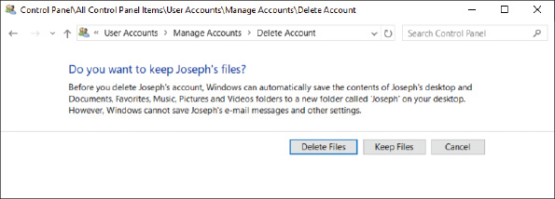
Error Messages and Problems (3 of 11)
Figure 15-39 Delete a user account and its settings and keep the files in the user profile

Slide 52
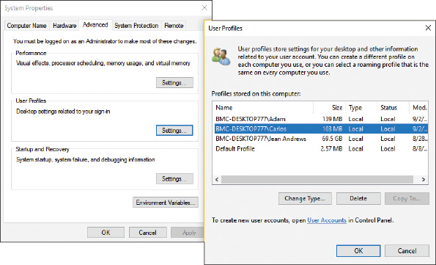
Error Messages and Problems (4 of 11)
Figure 15-41 Delete the user profile

Slide 53
Error Messages and Problems (5 of 11)
Error Messages on a Blue Screen
Blue screen of death (BSOD) errors are also called stop Errors
They happen when processes running in kernel mode encounter a problem and Windows must stop the system
A stop error can be caused by a corrupted registry, a system file that is missing or damaged, a device driver that is missing or damaged, bad memory, or a corrupted or failing hard drive
Stop errors can occur during or after startup

Slide 54
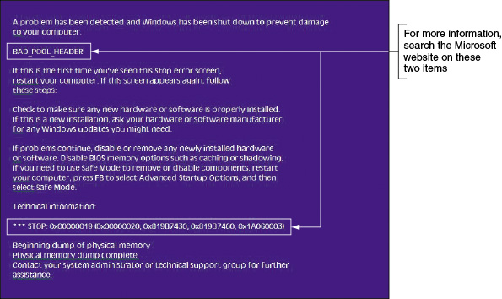
Error Messages and Problems (6 of 11)
Figure 15-42 A blue screen of death (BSOD) is definitively not a good sign; time to start troubleshooting

Slide 55
Error Messages and Problems (7 of 11)
Error Messages on a Blue Screen (continued)
What to do when you get a stop error:
Search Microsoft websites for the error
Disconnect any peripheral devices that might be causing trouble
Reboot the system and read information in Windows error message box or bubble
If possible, restart the system and enable boot logging
Restart a couple times
If that doesn’t fix the problem, launch Windows RE and restart Windows in Safe Mode with Networking

Slide 56
Error Messages and Problems (8 of 11)
Errors With Hardware and Device Drivers
If the blue screen names a device or device driver that caused the problem:
If driver has been recently updated and the Safe Mode desktop is loaded, open Device Manager and roll back the driver
Consider the device driver might have been updated along with a Windows update, try returning to a previous version of Windows
A Windows update might fix the problem
Use Device Manager to uninstall the device

Slide 57
Error Messages and Problems (9 of 11)
Errors With Hardware and Device Drivers (continued)
If the blue screen does not identify a device but names a program file:
Open File Explorer or Windows Explorer to locate the program file, right-click the file and select Properties from the shortcut menu
The Details tab tells you the purpose of the file
Reinstall the device or program that caused the problem
If you cannot start Windows in Safe mode:
Use Windows RE to open a command prompt window, back up the registry, open the Registry Editor
Drill down to the service or device key
Disable the service or driver by changing the Start value to 0x4
Reboot

Slide 58
Error Messages and Problems (10 of 11)
Errors With Services or Other Programs
Check Event Viewer (critical errors and warnings are recorded in the Administrative Events log)
Use Task Manager to stop the service or other program causing the error
Use Task Manager or the Service console to disable the service from launching at startup
Update Windows
If you are not sure which service or program is causing the problem, perform a clean boot or a Safe boot
Undo any recent changes to the system
Consider using System Restore
Use the Memory Diagnostics tool to check memory and use the chkdsk /r command to check the hard drive for errors

Slide 59
Error Messages and Problems (11 of 11)
Windows is Corrupted
Some possible problems with Windows system files and what to do about them:
Missing Boot Configuration Data
Try using the bootrec /rebuildBCD command
Improper Shutdown
Check Event Viewer for clues, apply Windows updates, verify memory with Memory Diagnostics, and use chkdsk /r to check the hard drive for errors
No graphics appear
Try a different monitor or onboard video port
Try launching a command prompt in Windows RE and use it to perform a System Restore

Slide 60
Chapter Summary (1 of 2)
When a system is turned on, startup BIOS/UEFI takes control and performs POST to examine hardware components and find an OS to load
Windows startup is managed by the Windows Boot Manager
Before a problem occurs, make sure you have good backups of user data and a system image, configure the F8 key at startup, and create recovery boot media
Windows RE can be started from within Windows, from the Windows setup DVD, from a recovery drive, or from a system repair disc
Tools for startup troubleshooting include startup repair, startup settings, System Restore, Safe Mode, enabling boot logging, SFC, and the chkdsk, diskpart, bootrec, and bootsect commands

Slide 61
Chapter Summary (2 of 2)
Tools that can be used to reinstall Windows are the Windows 10 previous version, a repair upgrade, Fresh Start, and a reset
If a hard drive contains valuable data but will not boot, you might be able to recover data by installing the drive in another system
Use the web to research stop errors on the error title and error number listed on the blue screen
Improper shutdowns are most likely hardware related
When a device or service causes the system to hang during a normal boot, boot into Safe Mode and disable the device or service

